Slide 1
How Counselors can Prepare for a Disaster in their Community and How They Can Help After
Bob Schmidt, LPC
Counselor.Bob@hotmail.com
www.DisasterMentalHealthPlan.com

Slide 2
What is one thing you could do to prepare if you somehow learned that in 6 months there was going to be a DISASTER in your community?

Slide 3
How do you minimize the number of PTSD cases?
How do you best help the underserved populations?
How can you quickly get trauma-informed services?

Slide 4
From Disaster to PTSD
Immediate Help (physical & emotional)
Crisis Counseling Program
Psychological First Aid Program
PsySTART Program
Acute Stress Disorder
Need Trauma-Informed Therapists
to treat survivors

Slide 5
Why we need to take action right away
Immediately after a disaster up to 33% of the people affected will have Acute Stress Disorder.
If they don’t get trauma-informed treatment ½ of them will end up with PTSD.

Slide 6
Are YOU trauma-informed?
Do you recognize the symptoms of trauma?
Do you have training and experience in one or more trauma-informed interventions?
Do you practice self care?
Many people in the helping professions end up suffering from Compassion Fatigue or Secondary Trauma.

Slide 7
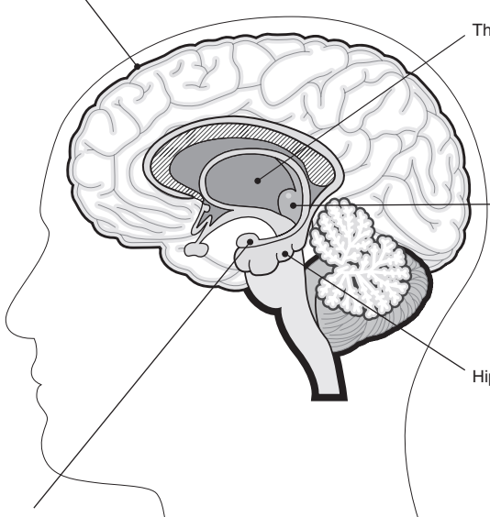
Trauma and the Brain
Frontal Lobe
Thalamus
Frontal Lobe: Responsible for thinking and reasoning
Amygdala: Responsible for the Fight, Flight or Freeze response
Hippocampus: Responsible for storing memories
Hypothalamus: Works with the pituituary gland to send hormones to the body
Thalamus: Relays sensory impulses to the cerebal cortex
Hypothalamus
Hippocampus
Amygdala

Slide 8
The amygdala’s job is to keep you safe, but . . .
When the brain is in the state of HYPERVIGILENCE. The amygdala is not very smart. It can’t tell a real threat from an imagined threat from an old memory.
It overpowers the frontal lobe, so reasoning and rational thinking is not always possible.

Slide 9
Calm the Amygdala and clear traumatic memories first
Brain Based trauma-informed interventions work with the brain from the bottom up.
Cognitive treatments work from the top down and as a result take longer and can be more stressful for the patient.

Slide 10
Effective Brain Based Trauma-Informed Interventions
EMDR: Eye Movement Desensitization and Reprocessing. Uses binaural stimulation.
EFT: Emotional Freedom Technique aka – Tapping
Brainspotting: Hold the eyes in a fixed position. May use music or nature sounds for binaural stimulation
MNRI: Masgutova Neuro-reflex Integration

Slide 11
PTSD TREATMENT COMPARISON CHART FROM THE VETERANS AFFAIRS WEBSITE
 | Cognitive Processing Therapy | EMDR | Prolonged Exposure | SSRI/SNRI (Antidepressant Medications)
What type of Treatment is this? | Psychotherapy TF-CBT | Psychotherapy | Psychotherapy Type of CBT | SSRI: Prozac, Paxil & Zoloft SNRI: Effexor
How does it work? | Teaches you to re-frame negative thoughts about the trauma | Helps you process and make sense of your trauma | Teaches you how to gain control by facing your fears. | Restores the balance of naturally occurring chemicals in your brain.
What will I do? | Talk about your thoughts. Writing assignments and worksheets | Call the trauma to mind while focusing on an external motion or sound. | Talk about the trauma. Start doing safe things you have been avoiding | Take a pill at regular times each day.
Is it effective? | Yes, 53 out of 100 people will no longer have PTSD | Yes, 53 out of 100 people will no longer have PTSD | Yes, 53 out of 100 people will no longer have PTSD | Yes, 42 out of 100 people will no longer have PTSD
How long does the treatment last? | Weekly sessions for around 3 months. | Weekly sessions for around 2 to 3 months | Weekly sessions for around 3 months. | Variable. Symptoms may return if you stop Taking the medications.

Slide 12
 | Cognitive Processing Therapy | EMDR | Prolonged Exposure | SSRI/SNRI (Antidepressant Medications)
What are the risks? | Temporary discomfort when talking or writing about the trauma. | Temporary discomfort when thinking about the trauma. Should say, Mild Discomfort | Temporary discomfort when talking about and confronting reminders of the trauma. | Potential side effects such as headache, sleep problems, dry mouth, upset stomach, weithg grain and sexual side effects.
Group or Individual? | Both | Individual | Individual | Individual
Will I need to talk about my trauma? | Depends on the type of CBT | Optional | Yes | No
Will I have homework? | Writing assignments and worksheets | No (This is not true) | Listen to session recordings. Do safe activities. | No
How available is this in V.A.? | Moderate | Low | Moderate | High
Does the V.A. have an app for this? | CPT Coach | No | PE Coach | No

Slide 13
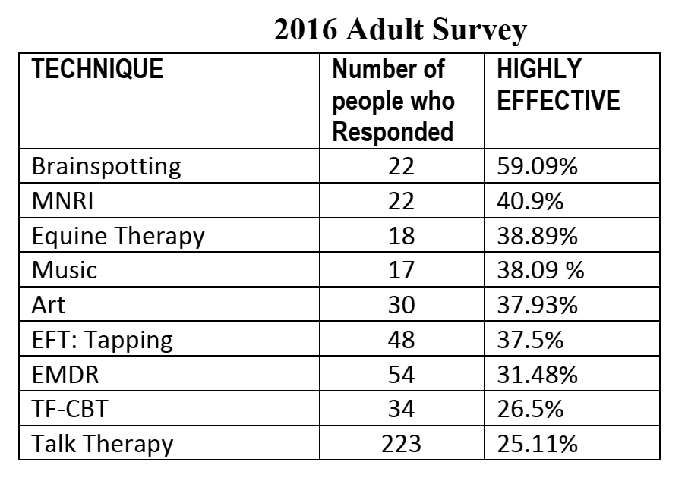
EXERPT FROM THE 2016 SURVEY DONE BY THE NEWTOWN SANDY HOOK COMMUNITY FOUNDATION

Slide 14
2017 SURVEY

Slide 15
Suggestions
Learn about trauma. It will also improve your practice.
Learn trauma-informed interventions.
Get trained in two trauma-informed techniques
Get a list of trauma-informed therapists in your area.

Slide 16
More suggestions to prepare
Find out what crisis counseling programs are available in your community.
Compile lists of trained crisis counselors or Psychological First Aid counselors (Red Cross & FEMA).
Talk with your mayor or town leader about forming collaborative groups to prepare for a disaster.

Slide 17
COVID-19 Pandemic is like all disasters
Up to 16% of healthcare workers could develop PTSD
Anxiety and depression will be significantly higher for many years
Many people did not have a chance to grieve
Complex Grief
Traumatic Grief
Substance Abuse is already on the rise!

Slide 18
A ROADMAP Chapter 10
Preparing for a disaster
Immediately after
A year or more after

Slide 19
Available from Routledge and Amazon.com 20% off Discount code: BSM20
How to create collaborative groups to deal with every disaster issue.
Lessons learned from disasters
Trauma and trauma-informed interventions; both brain-based and cognitive techniques
Wellness programs and techniques that are effective in addition to counseling.
Effective guide before and after a disaster.

